Slide 3
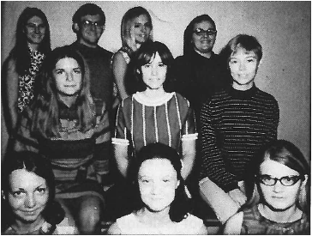
1st graduating PTA Class
June 1969
St. Mary's Junior College, Minneapolis, MN
11 graduates
(1 not shown)
Notes:
Photo courtesy of St Catherine University.

Slide 4
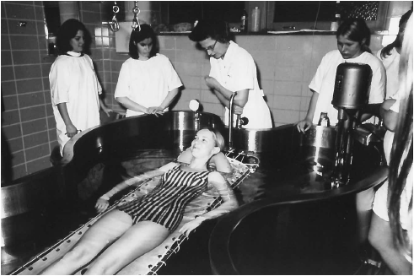
1971
PTA students
St. Mary’s Junior College
Notes:
Source: St. Mary’s Junior College physical therapist assistant program / St Catherine’s University.

Slide 5
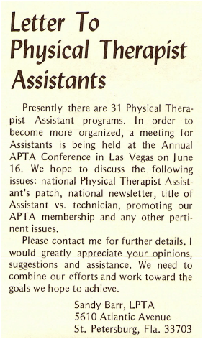
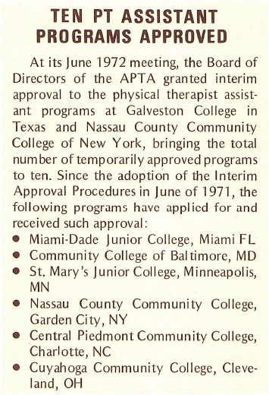
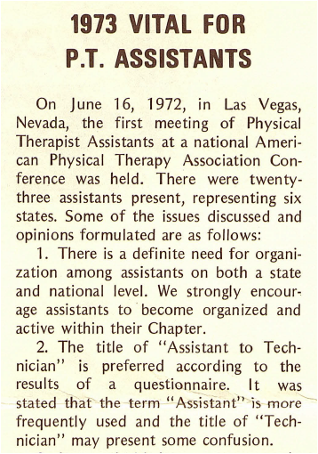
1972
Notes:
Sources (left to right):
Progress Report, 1972, Vol 1, No. 4 (Apr.), p. 2.
Progress Report, 1972, Vol 1, No. 7 (July), p. 3.
Progress Report, 1972, Vol 1, No. 12 (Dec.), p. 2.

Slide 6
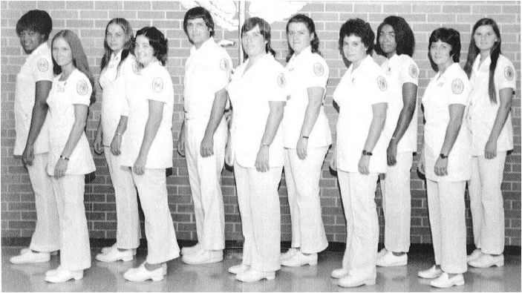
Greenville Technical College
1973
Notes:
The 1973 graduating class of PTAs from Greenville Technical College.
Source: Celebrating a Milestone: 35 Years of PTAs. Wojciechowski, Michele.PT: Magazine of Physical Therapy; Alexandria Vol. 12, Iss. 2, (Feb 2004): 42-49.

Slide 7
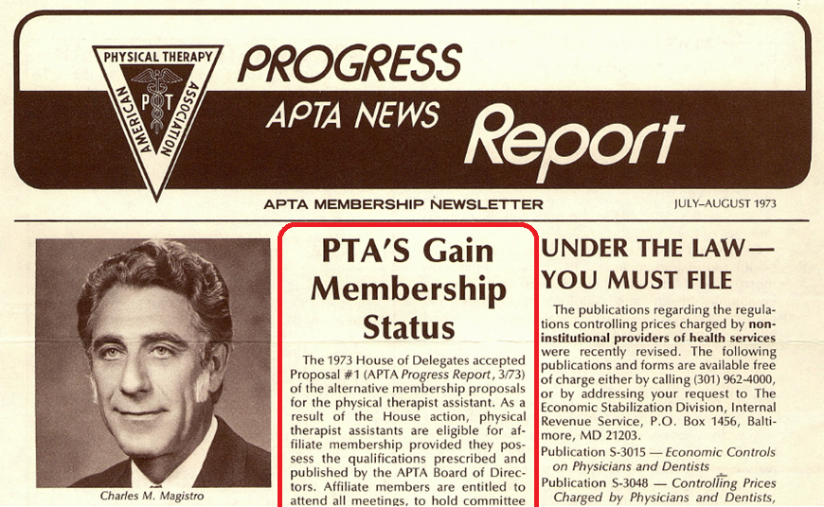
1973
Notes:
Progress Report, Vol. 3, No. 7, 1973 (July-Aug), p. 1.

Slide 8
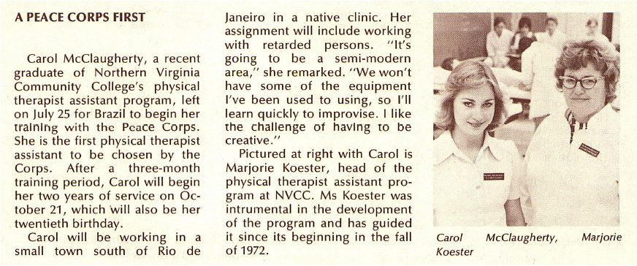
Carol McClaugherty - 1st PTA serving in Peace Corps
1974
Notes:
Progress Report, Vol. 3, No. 7, 1974, p. 3.

Slide 9
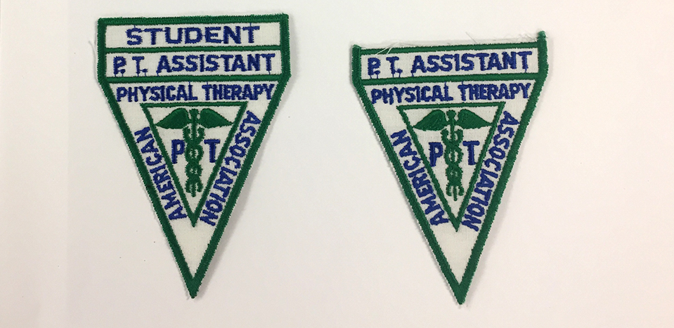
1976
Notes:
© American Physical Therapy Association, 2018.

Slide 10
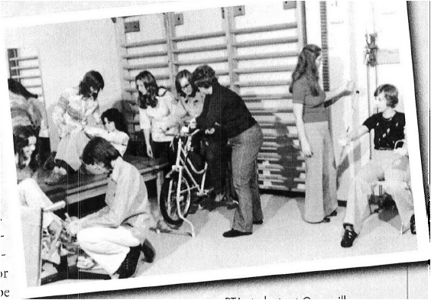
PTA students
Greenville Technical College
circa 1976
Notes:
Source: Wojciechowski M. “Celebrating a Milestone: 35 Years of PTAs,” PT: Magazine of Physical Therapy, 2004 (Feb.); 12(2): 42-49.

Slide 11
076.224-010
PHYSICAL THERAPIST ASSISTANT
(medical ser.)
physical therapy technician
Recognition of the young profession in the Dictionary of Occupational Titles, Employment and Training Administration, US Department of Labor
1978
Notes:
Source: "Good News Dept...," Progress Report, 1978, 7(3): 1. “PTs and PTAs were assigned the codes 076.121-014s and 076.224-010s, respectfully. These are the index numbers assigned physical therapists and physical therapist assistants in the latest Dictionary of Occupational Titles, recently published by the US Department of Labor's Employment and Training Administration. Each of the 20,000 job descriptions in the mammoth volume has a unique 9-digit code number and is grouped systematically with similar jobs. The good news for PTs and PTAs is that their new code numbers represent a significant upgrading. The Department of Labor has now officially dubbed them bona fide professionals.”

Slide 12
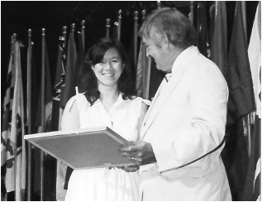
Melinda Hong, SPTA
1st SPTA winner, Mary McMillan Scholarship, $500
1980
Notes:
Source: "Campus Reports: Students," Progress Report, 1980, 9(7): 4. “At Annual Conference, a Mary McMillan Scholarship was awarded to a PTA student for the 1st time in the scholarship's history: Melinda Hong. A recent change in the scholarship criteria has allowed students in physical therapist assistant programs to be recommended for the scholarships. Hong, a student in the PTA program at De Anza College in Cupertino, California, will receive the $500 award. Hong already holds an AA in Physical Education from City College of San Francisco and a BA in Physical Education from California State University, San Francisco.”

Slide 13
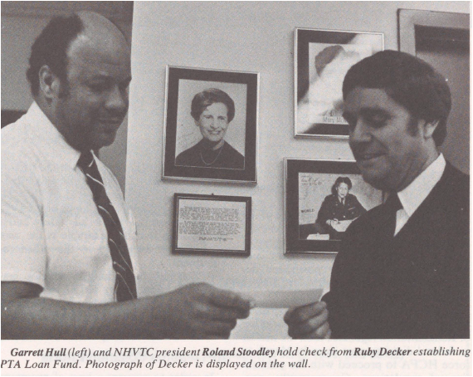
1982
Reconstruction Aide Ruby Decker creates
PTA Student Fund
at NH VTC
Notes:
Source: “Decker Provides PTA Student Fund,” Progress Report, 1982, 11(7): 5.

Slide 14
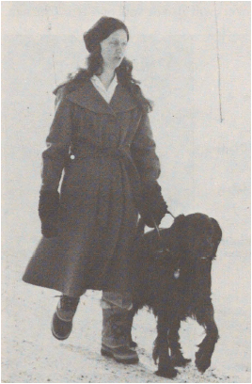
1986
Debbie Schuerman, PTA (& later PT), and her seeing eye dog A.J.
1st totally blind student to graduate from St. Mary’s Junior College 2-year PTA program
Notes:
Source: McDonnel, JM. “Blind Physical Therapists Use Sense of Touch to Provide Care,” Progress Report, 1986, 15(4): 12. “In fact, the skepticism from sighted health professionals isn't unusual, Debbie Schuerman says. After graduating from high school, Schuerman applied to a physical therapy program, but was rejected. A vocational trainer also told her that her dream of becoming a physical therapist was impossible. So instead of pursuing physical therapy as a career, she attended a junior college and then transferred to Moorhead State College in Moorhead, Minnesota, where she earned a degree in speech therapy. Still interested in becoming a physical therapist, she attended St. Mary's Junior College and was the first totally blind student to graduate from the school's two-year physical therapist assistant program. She later earned a degree in physical therapy at the College of St. Scholastica in Duluth. When Schuerman (then certified as a physical therapist assistant) applied for a position at Mount Sinai Hospital, a 173- bed hospital in Minneapolis, the physical therapist in charge was negative about the idea of hiring a blind assistant. He changed his mind, however, during the interview. Health professionals, says Schuerman, often find it difficult to accept disabled coworkers on an equal basis, but disabled individuals should push forward. "I'm all for people with any kind of disability getting into the medical field. People with disabilities have been on the receiving end for so long," she says. “

Slide 15
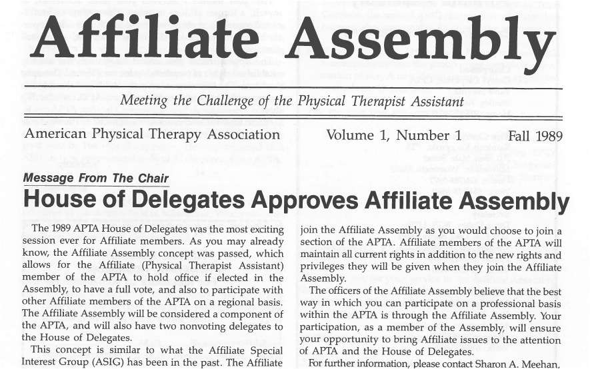
1989
Notes:
Affiliate Assembly newsletter, Fall 1989.

Slide 16
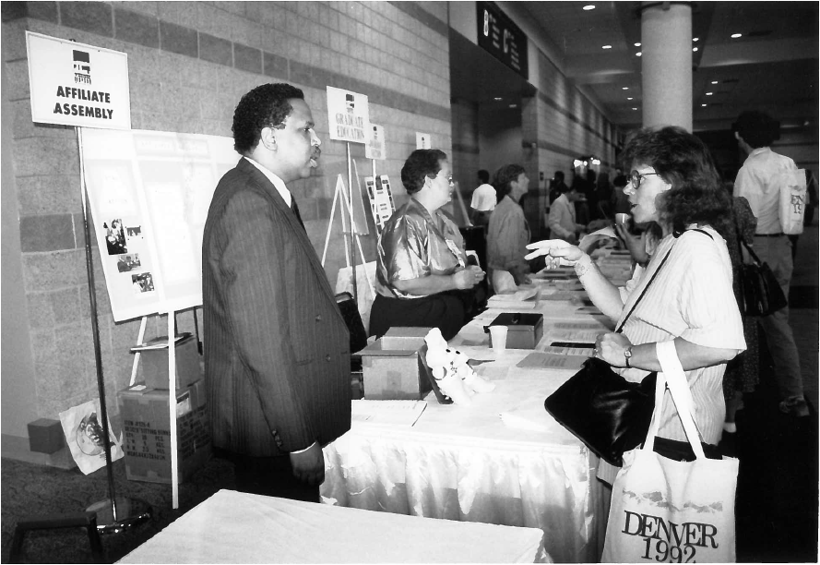
1992
Affiliate Assembly booth
PT 1992
Denver
Notes:
Source: PT 1992 conference photos.

Slide 17
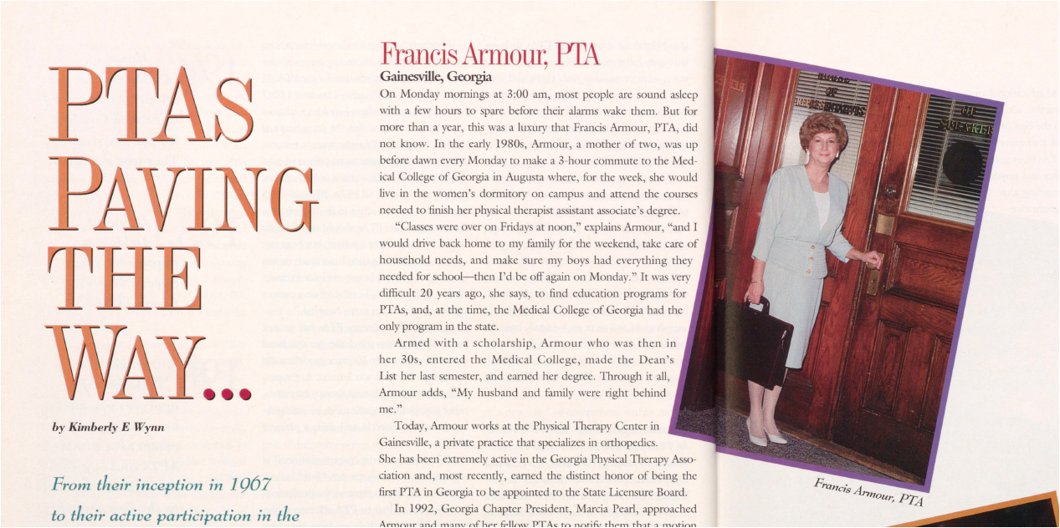
1993
Notes:
Wynn, Kimberly E. "PTAs Paving the Way…," PT Magazine, April 1993, 1(4):40-45.

Slide 18
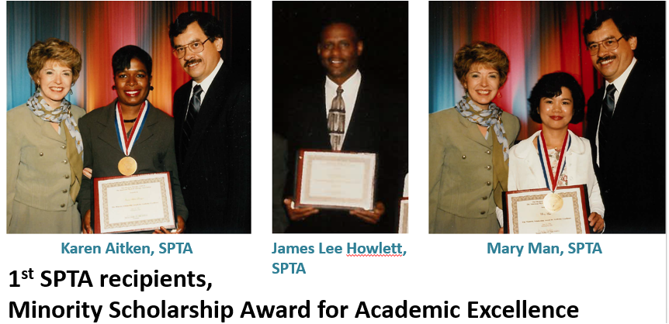
1996
Notes:
Photos (left to right): Karen Aitken-Douyon, SPTA, Essex County College; James Lee Howlett, SPTA, Wallace State College; May Man, SPTA, Tulsa Junior College. Shown with the winners in the Aitken and Man photos are Marilyn Moffat, PT, PhD, FAPTA, then President of APTA. Unidentified gentleman on far right in 2 images.
Source: Honors & Awards booklet, 1996.

Slide 19
1999
Notes:
The Voice, published quarterly, was the official publication of the National Assembly of Physical Therapist Assistants, a component of the American Physical Therapy Association.

Slide 20
1999
Karen Jorgensen, PTA, President, National Assembly of Physical
Therapist Assistants (right),
with
Jan K. Richardson, PT, PhD, OCS, President, APTA (left)
Notes:
Source: “The National Assembly: One Year Later,” PT Magazine, 1999;7(9):34-39.

Slide 21
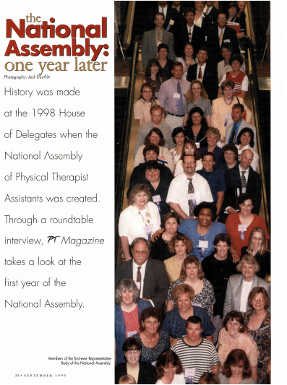
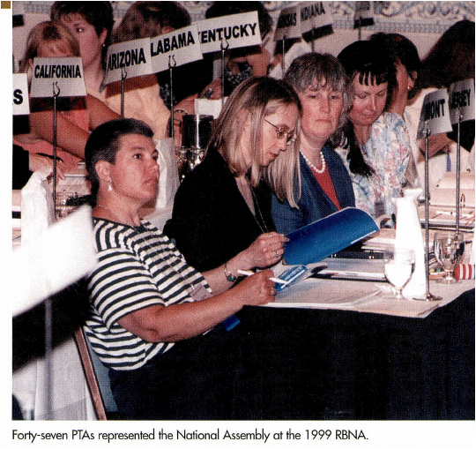
Notes:
Source: “The National Assembly: One Year Later,” PT Magazine, 1999;7(9):34-39.

Slide 22
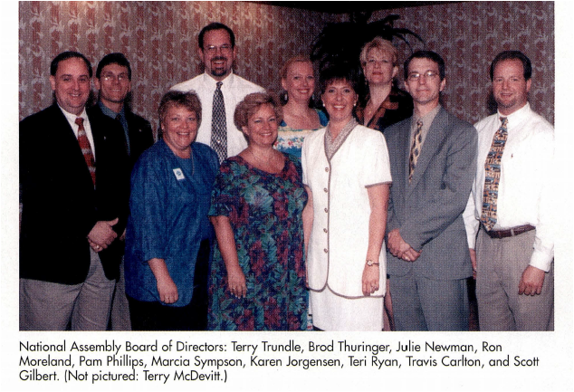
National Assembly Board of Directors
1999
Notes:
“The National Assembly: One Year Later,” PT Magazine, 1999;7(9):34-39.

Slide 23
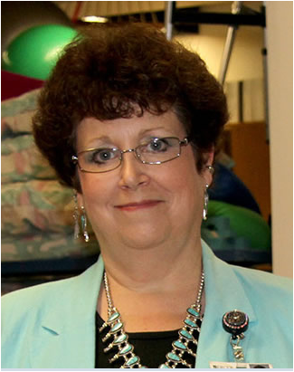
2000
F.A. Davis Award for Outstanding Physical Therapist Assistant Educator
Barbara J. Behrens, PTA
1st PTA to win the award

Slide 24
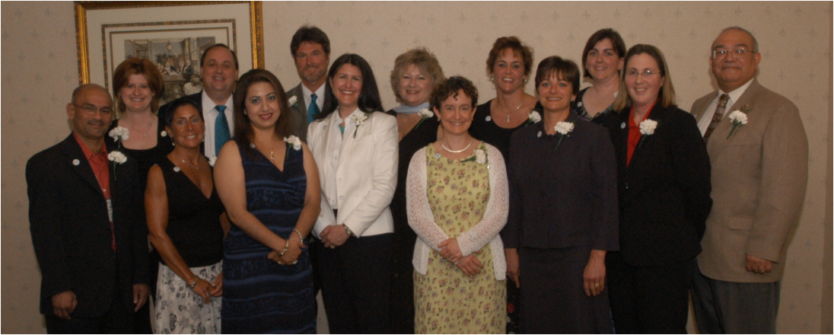
14 out of the 79 1ST recipients of Advanced Proficiency for the Physical Therapist Assistant
2005
Notes:
Source: PT 2005 conference photos.

Slide 25
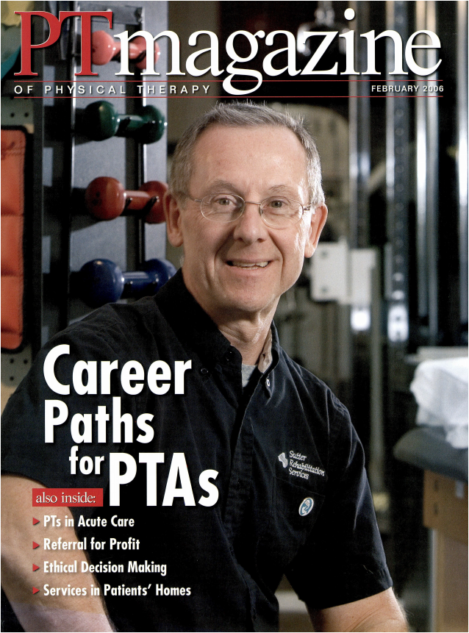
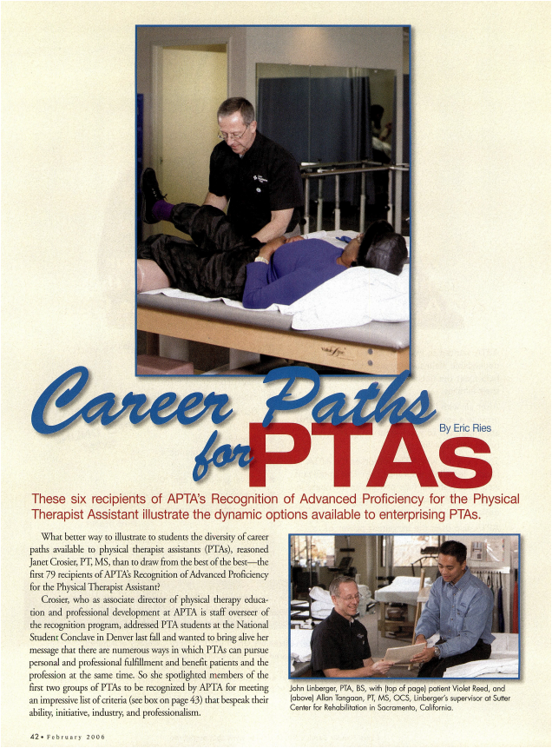
2006
John Linberger, PTA, MS
Notes:
Ries E. "Career Paths for PTAs," PT Magazine, 2006;l4(2):42-50.

Slide 26
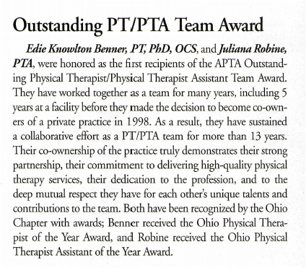
2006
1st APTA Outstanding Physical Therapist / Physical Therapist Assistant Team Award
Edie Knowlton Benner, PT, PhD, OCS
Juliana Robine, PTA
Notes:
“Honors and Awards,” PT Magazine, 2006; 14(9): 78-86. Award info appears on page 83.

Slide 27
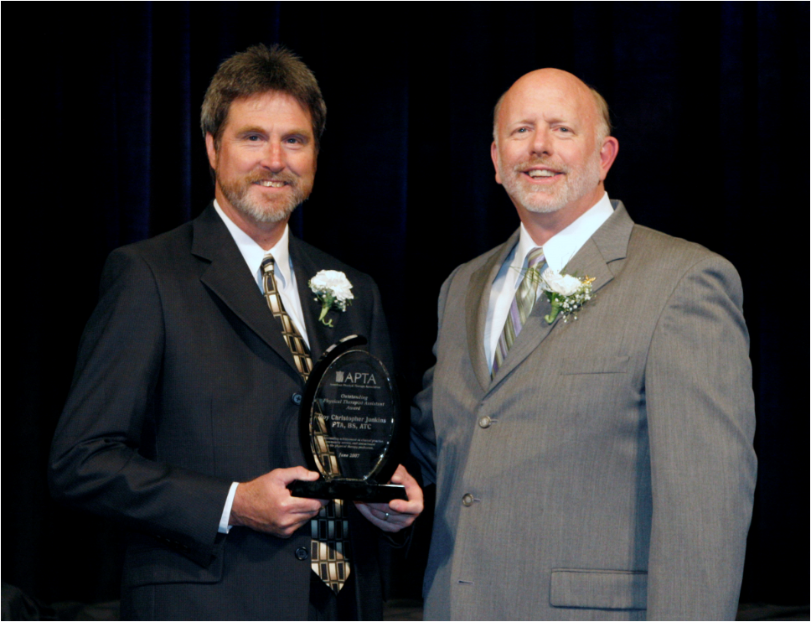
2007
1st APTA Outstanding Physical Therapist Assistant Award
Roy Christopher Junkins, PTA, ATC (left)
Notes:
“Honors and Awards,” PT Magazine, 2007; 15(9): 37-47. Award info appears on page 44.
Photo: Award presented by APTA President R. Scot Ward, PT, PhD, FAPTA (right).
From the 2007 American Physical Therapy Honors & Awards booklet, page 30: “Roy Christopher Junkins, PTA, BS, ATC, has had an extensive career as a physical therapist assistant that spans the past 3 decades. Mr Junkins was among the first group of physical therapist assistants to be recognized for recognition in Advanced Proficiency in Musculoskeletal practice. As a full-time PTA, Mr Junkins has worked in a variety of settings from hospital in-patient and out-patient facilities to private practice. Currently, he is the co-owner of Dosher Physical Therapy Associates in Easley, South Carolina. Throughout his career, Mr Junkins has shared his enthusiasm for health, wellness, and the physical therapy profession. Within his community, he has enjoyed coordinating and participating in several health fairs, road races, "Relay for Life" events, and assisting with the March of Dimes. As a mentor, he has participated in APTA's physical therapist assistant mentorship program and has interacted with students as a clinical instructor and as an adjunct instructor for Greenville Community College. Mr Junkins has been very active within the South Carolina Chapter. He has served as an affiliate delegate, chair of the chapter's Affiliate Special Interest Group, as its representative to the Representative Body of the National Assembly, has worked on several committees, and as a member of the chapter's Board of Directors. Currently, he holds an appointment to the South Carolina Board of PT Examiners. In 2001, the South Carolina Chapter recognized Mr Junkins as the first recipient of the Chris Junkins Award for Clinical Excellence, named in his honor. He has served as the vice president and delegate for the National Assembly, editor for the affiliate newsletter, and as a volunteer assisting the APTA Elections and Tellers Committee for the national office elections held during the House. At this time, Mr Junkins is serving an appointment on the APTA Advisory Panel for Member Recruitment and Retention.”

Slide 28
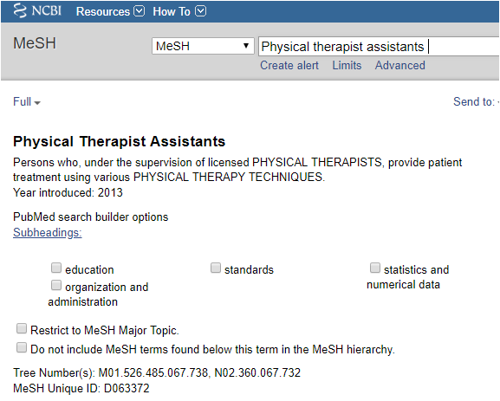
2013
MEDLINE index adds
Physical Therapist
Assistants
to
Medical Subject
Headings (MeSH)
Notes:
Source: https://www.ncbi.nlm.nih.gov/mesh/?term=Physical+therapist+assistants. Accessed February 28, 2019.

Slide 29
2014
Recognition of Advanced Proficiency for Physical Therapist Assistant
transitions to
PTA Advanced Proficiency Pathways (APP)
Notes:
Crosier, J. "Have We Got an APP for You," PT in Motion, 2014 (July); 6(6):60-61. Available from http://www.apta.org/PTinMotion/2014/7/PTAsToday/. Accessed February 28, 2019.

Slide 30
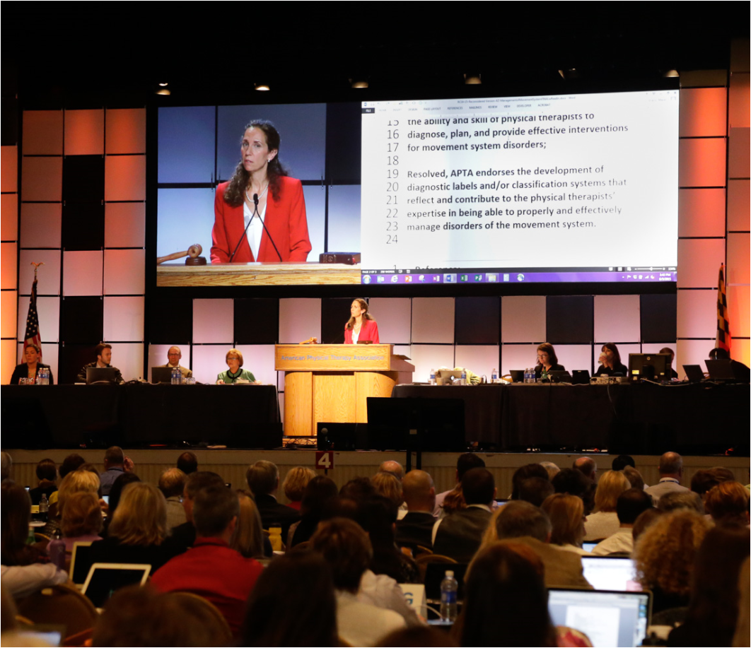
2015
APTA House of Delegates passed RC 3-15:
APTA chapters & sections may grant a full vote to physical therapist assistant members at the component level.
37 chapters & 9 sections have implemented the change to date (2/19)
Notes:
Source: (1) 2015 House of Delegates Minutes; (2) Component Governance Department, APTA (2/19).

Slide 31
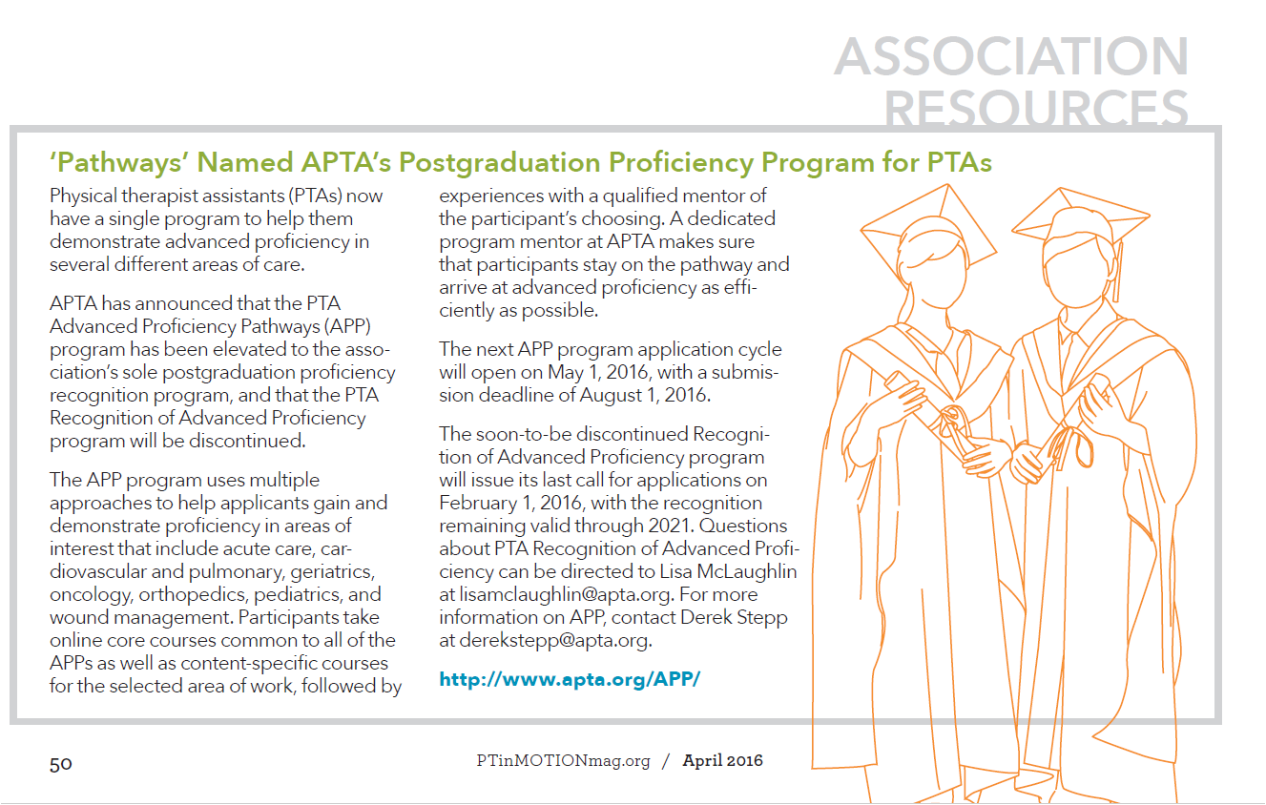
2016
Notes:
Source: “‘Pathways’ named APTA’s postgraduation proficiency programs for PTAs,” PT in Motion, 2016 (April); 8(3): 50. Accessible from http://www.apta.org/PTinMotion/2016/4/ProfessionalPulse/, (Scroll down to the “Association Resources” section.) Accessed February 28, 2019.

Slide 32
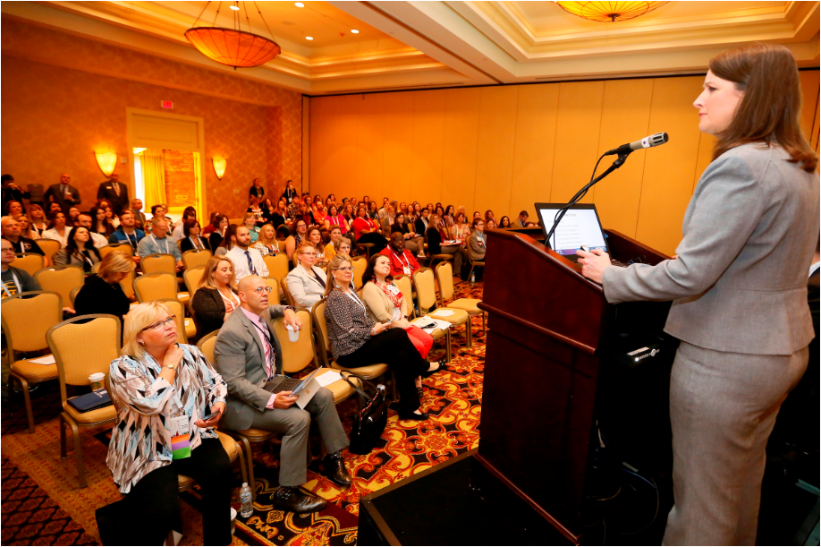
2018
PTA Town Hall
Notes:
Source: NEXT 2018 Conference photos.

Slide 33
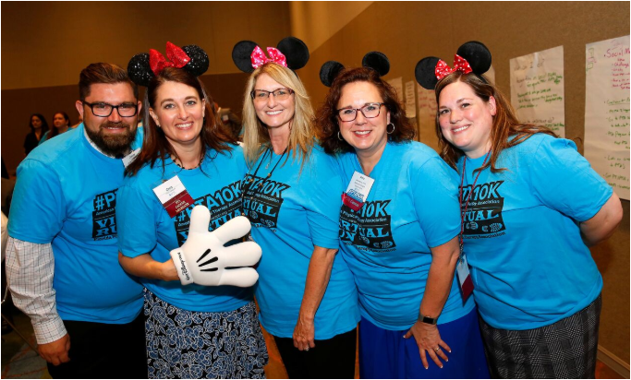
2018
Notes:
Source: NEXT 2018 Conference photos.

Slide 34
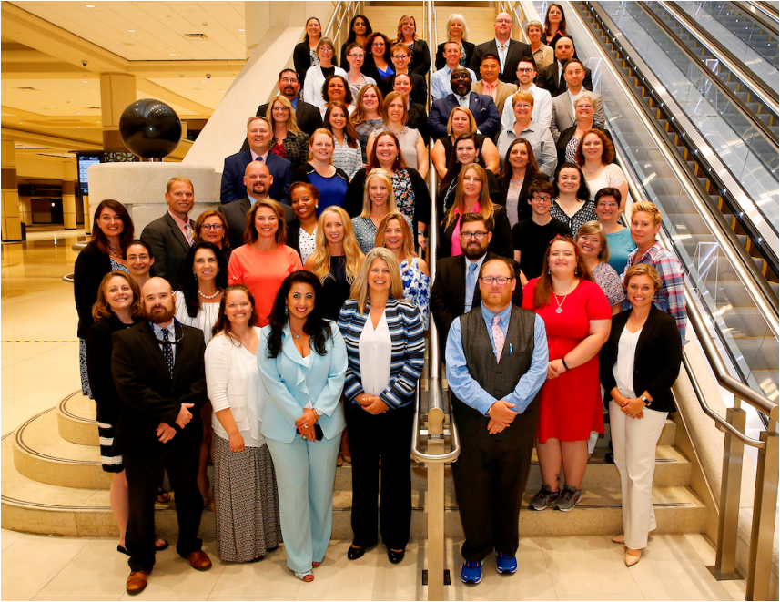
2018
PTA Caucus
Notes:
Source: NEXT 2018 Conference photos.

Slide 35
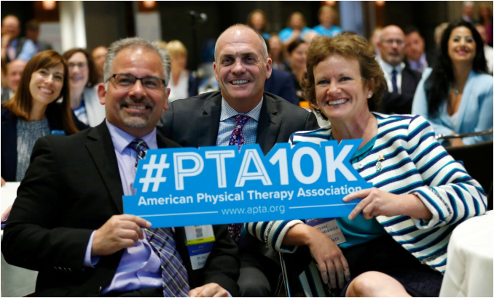
2018
Notes:
Front row (left to right): Anthony DiFilippo, PT, DPT, MEd, APTA Board of Directors; Justin Moore, PT, DPT, Chief Executive Officer, APTA; Sharon L. Dunn, PT, PhD, President, APTA. Source: NEXT 2018 Conference photos.

